Slide 1
Geothermal Energy
Dylan

Slide 2
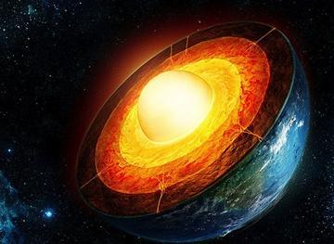
What is Geothermal Energy?
Geothermal Energy is a renewable energy source.It uses heat from molten and the watercycle which is a type of renewable energy source. (2)

Slide 3
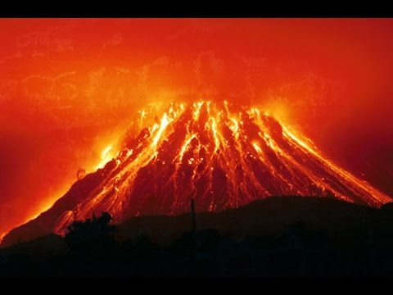
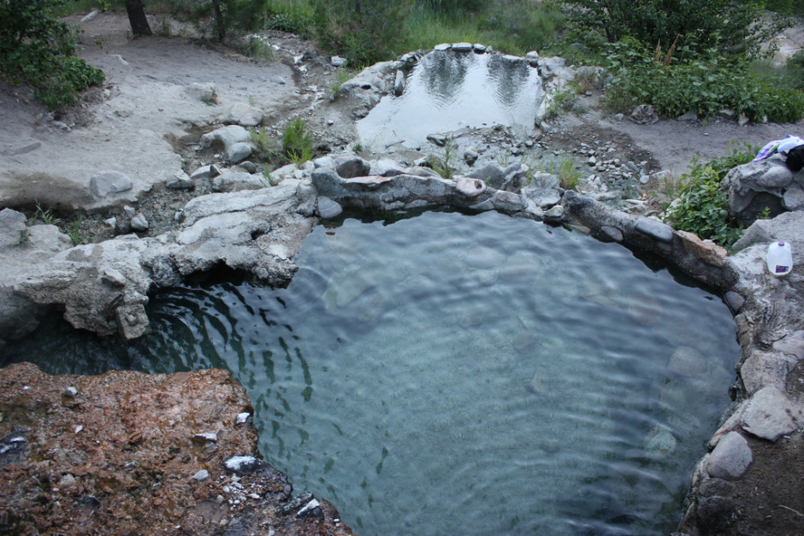
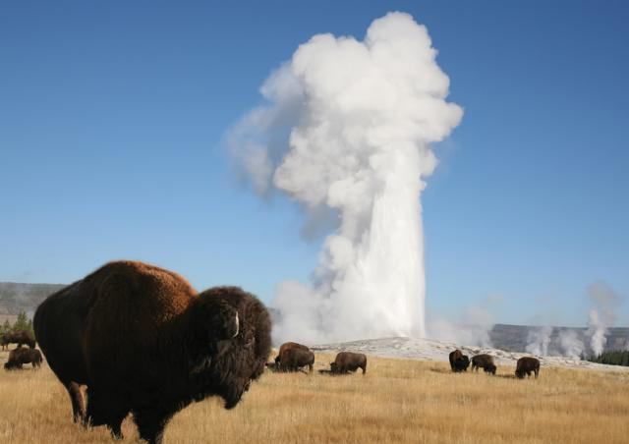
Where is Geothermal Energy?
Volcanos
Geysers
Hot Springs (1)

Slide 4
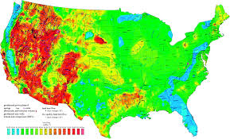
States that use Geothermal Energy
California 76%
Nevada 18%
Utah 3%
Hawaii 2%
Oregon 1%
Idaho 0.3%
New Mexico 0.1%
(1)

Slide 5
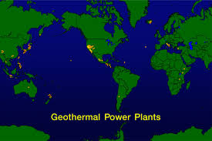
Countries with geothermal energy production
United States
Philippines
Iceland
(1)

Slide 6
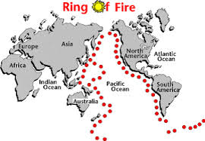
Where is the Ring of fire?
The Ring of Fire goes on the edges of South America, North America, Asia and Australia. (1)

Slide 7
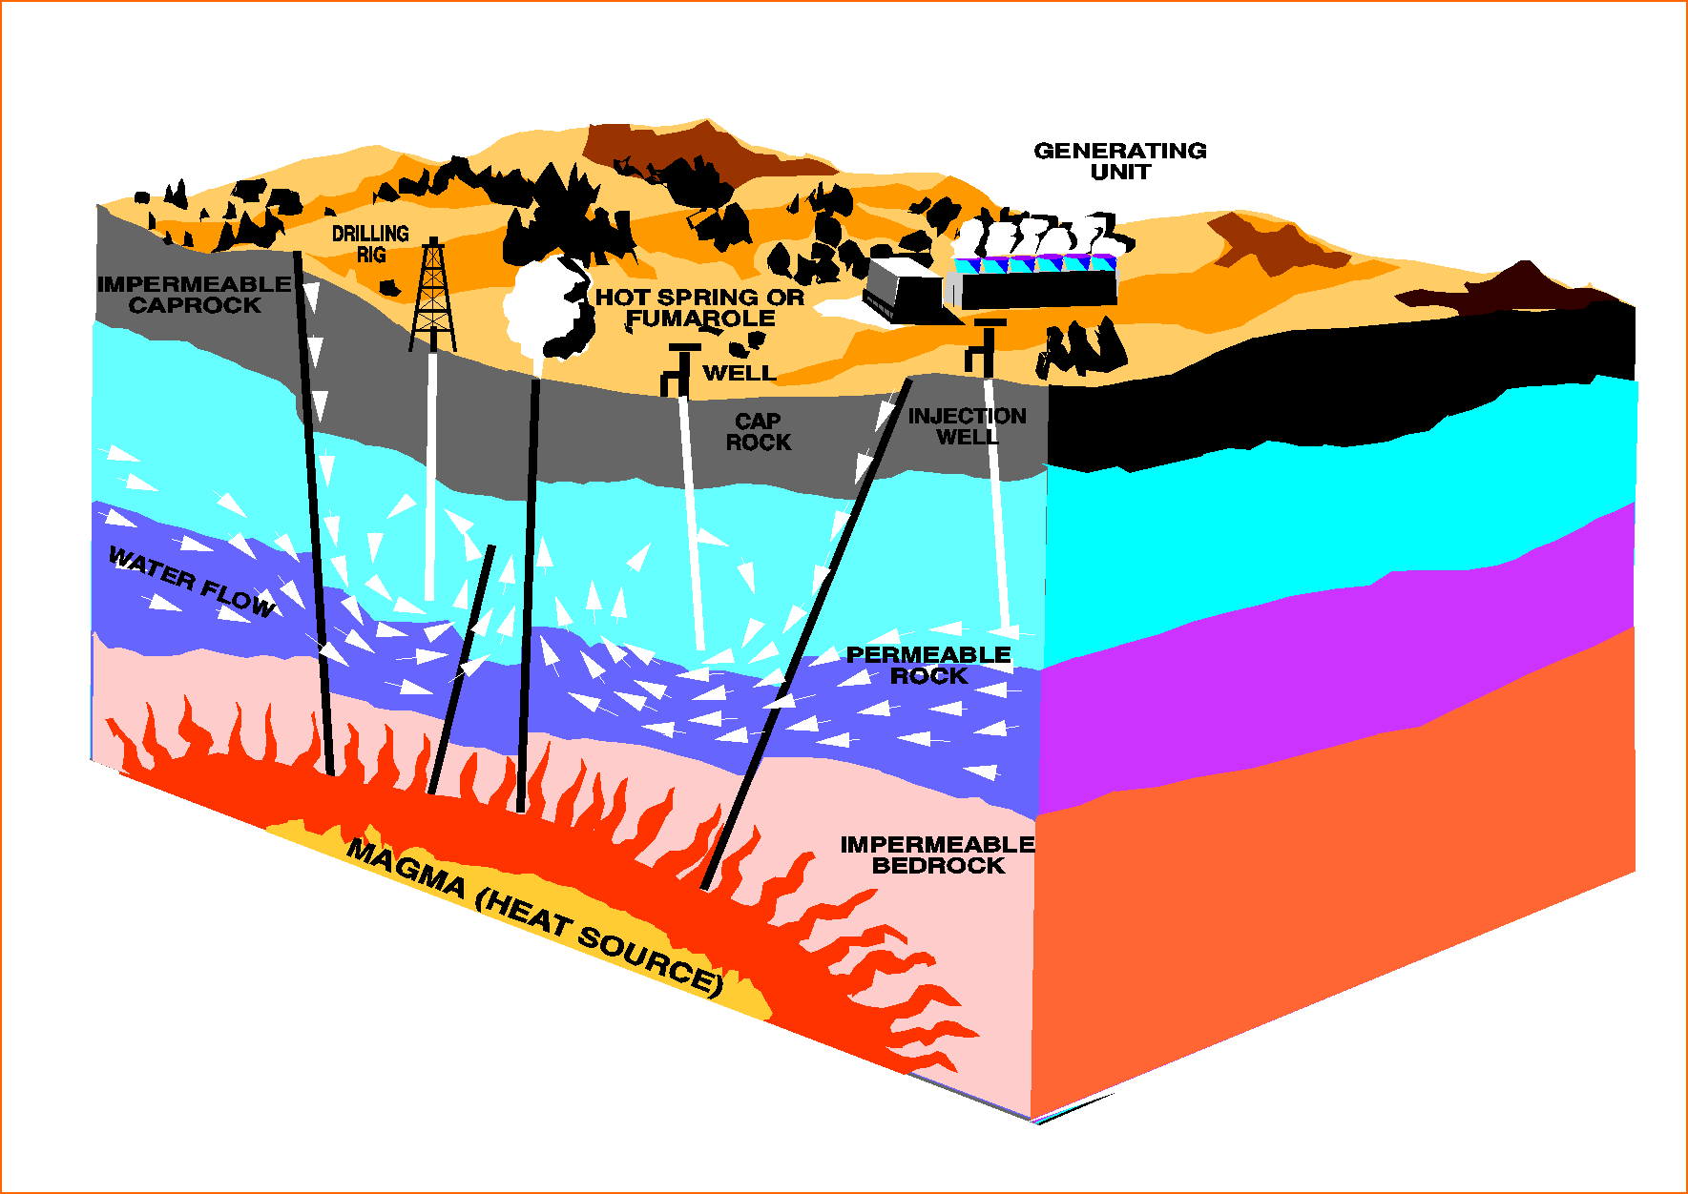
How is Geothermal Energy is made?
Geothermal Energy is made by the earth’s core,which is a slow decay of radioactive particles. (1)

Slide 8
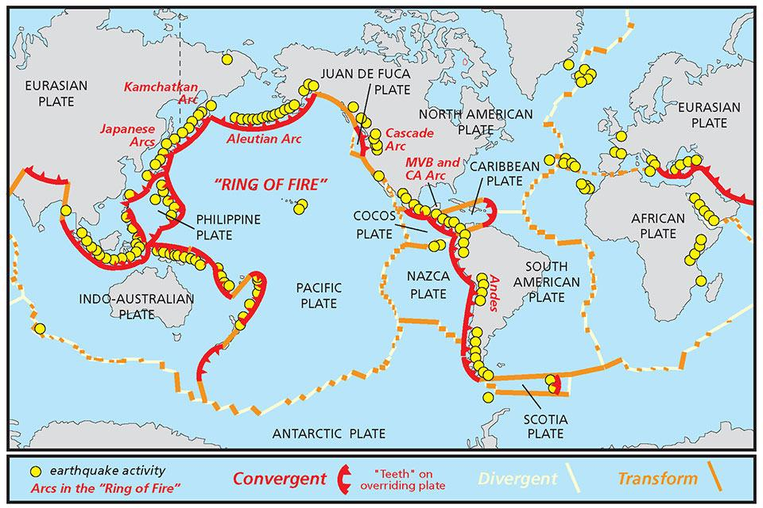
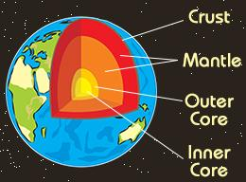
Pieces of the earth’s crust
Pieces of the earth’s crust are called plates.The earth has four layers.
Iron core- magma
Outer core- magma
Mantle- 1,800 miles thick rock, magma.
Crust- 3-5 miles under the ocean’s floor 15-35 miles under continents. (1)

